Slide 2
Content
Company Snapshots
Business description
Financial Analysis
Market position
Announcements and News

Slide 4
OVERVIEW...
Date of establishment : 1991
Corporate Address: 806 Siddharth,96 Nehru Place, New Delhi-110019, Delhi www.hcltech.com
Management Details: Chairperson - Shiv Nadar MD - Shiv Nadar
Business Operation: IT – Software
Background:
HCL Technologies is a leading global IT services company, working with clients in the areas that impact and redefine the core of their businesses. Since its inception into the global landscape after its IPO in 1999, HCL focuses on 'transformational outsourcing', underlined by innovation and value creation, and offers integrated portfolio of services including software-led IT solutions, remote infrastructure.
Financials: Total Income - Rs. 69607.5 Million ( year ending Jun 2011) Net Profit - Rs. 11982.8 Million ( year ending Jun 2011)
Bankers Auditors :Price Waterhouse & Co.

Slide 5
Key Executives of the Company….
S.No Name Designation
1 Shiv Nadar Chairman
2 Manish Anand Company Secretary
3 Vineet Nayar Vice Chairman
4 R Srinivasan Non Executive Director
5 T S R Subramanian Non Executive Director
6 Robin Abrams Non Executive Director
7 Ajai Chowdhry Non Executive Director
8 Subroto Bhattacharya Non Executive Director
9 Amal Ganguli Non Executive Director
10 P C Sen Non Executive Director

Slide 6
BUSINESS DECCRIPTION

Slide 7
Company History….
HCL Technologies is a leading global IT services company, working with clients in the areas that impact and redefine the core of their businesses.
HCL focuses on 'transformational outsourcing', underlined by innovation and value creation, and offers integrated portfolio of services including software-led IT solutions, remote infrastructure management, engineering and R&D services and BPO.]
HCL has global partnerships with several leading Fortune 1000 firms, including several IT and technology majors.
Provides services to industry sectors including financial services, manufacturing, aerospace & defense, telecom, retail & CPG, life sciences & healthcare, media & entertainment, travel, transportation & logistics, automotive, government and energies & utilities.

Slide 8
Recognitions….
HCL Technologies has been named as one of Britain's Top Employers 2010 by the Corporate Research Foundation (CRF) Institute, for the fourth consecutive year.
HCL Technologies has been conferred with the prestigious ‘Golden Peacock Innovation’ Award for its MTaaS™ (a Business Service Management centric service delivery platform) offering in the IT Sector category in October, 2009.
HCL Customer Standard Parking Wins Oracle’s ‘Empower the Green Enterprise’ Award
HCL Receives 6 HR Congress Awards 2008 – a recognition for having great human resources practices
India’s Most Preferred Personal Computer Brand – CNBC AWAAZ Consumer Award 2007
HCL Technologies (HCL) was named Meritorious Performance Supplier in Sun Microsystems' 2007 Supplier Awards program.
The award recognize companies that make outstanding contributions to Sun's record of delivering superior technology, quality service and excellent value to its customers.

Slide 9
FINANCIAL ANALYSIS

Slide 10
Annual Results in brief…. (in crores)
 | Jun ' 11 | Jun ' 10 | Jun ' 09 | Jun ' 08 | Jun ' 07
Sales | 6,794.48 | 5,078.76 | 4,675.09 | 4,615.39 | 3,768.62
Operating profit | 1,516.37 | 1,365.16 | 1,208.09 | 941.79 | 929.45
Interest | 101.39 | 101.36 | 28.09 | 19.07 | 12.97
Gross profit | 1,581.25 | 1,426.85 | 1,445.81 | 1,093.12 | 1,355.90
EPS (Rs) | 17.40 | 15.57 | 14.88 | 11.72 | 16.60

Slide 11
Annual sales data….
Product Name Year Month Sales Qty. Sales Value % of STO
Income from
Software Services 2011 06 0.00 66108.00 97.30
Software Licenses
(Unlimited Users) 2011 06 0.00 606.90 0.89
Others 2011 06 183666.00 464.00 0.68
Routers 2011 06 943.00 319.50 0.47
Switches 2011 06 506.00 193.30 0.28
Servers 2011 06 463.00 145.60 0.21
Storage Devices 2011 06 17.00 107.50 0.16

Slide 12
MARKET POSITION

Slide 13
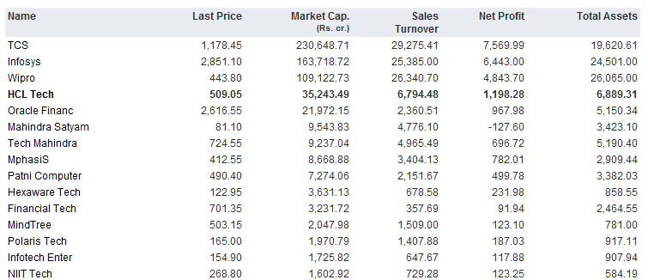
COMPETITIVE POSITION OF THE COMPANY…

Slide 14
PARTNERS ANSD COMPANY ALLIANCES OF HCL TECH. LTD.

Slide 16
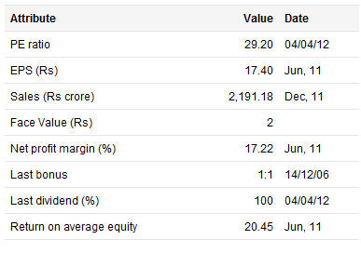
Here is the recent news…….
HCL Tech Q2 profit rises 43 pct, shares rally.
India's HCL shares rise 4 pct in pre-open after result.
HCL and Cisco Launch South Africa Global Centre of Excellence Offering Customer and Partner Support throughout Africa.
Report card:

