Slide 2
Industry
overview

Slide 3
Telecom industry overview…..
Facts of the industry:
Total telecom subscribers: 906.93 (at the end of September 2011)
The tele density in India has reaches 67.67% during January 2011
Urban: 150.67%
Rural: 32.11 %
According to the latest report released by Telecom Regulatory Authority of India (TRAI),
India has 538.38 million Urban Subscribers
267.74 million Rural subscribers.
The mobile growth in rural areas is higher at 3.07% as compared to urban which was about 2.06% in January.
One of the biggest telecom market in the world.
The average revenue per user (ARPU)
GSM-Full Mobility service declined by 10.16%, from Rs 122 to Rs 110 (2.46 USD),decrease of 33.1%.
CDMA – full mobility service declined by 1.34%, from Rs 74 to Rs 73 (1.63 USD. Hence declined by 17.5%.

Slide 4
Telecom industry overview…..
The following bar chart depicts the revenue from the various telecom services for the financial year 2010-2011.

Slide 5
Telecom industry overview…..
Telecom revenue for the year 2010-2011:
The India telecom industry expected to grow at a compound annual growth rate (CAGR) of 15.8 per cent between 2010 and 2014 and will touch revenues of Rs.3,77,683 Crore ($ 82 billion).
The India telecom services and mobile handsets market will grow at 16.7 per cent in 2012 (over 2011) and will touch revenues of Rs.2,88,832 Crore
mobile and fixed line services will contribute Rs.2,05,454 Crore
the India mobile handsets market which includes feature phones and smart phones will contribute Rs.83,377 Cr..
The revenue contribution from the public sector telecom companies in 2010-11 was 20.37% (previous year 24.82%) and from private sector firms was 79.63% (previous year 75.18%).

Slide 6
KEY PLAYERS…

Slide 7
There are 3 types of players in the telecom industry
State owned companies
MTNL
BSNL
Private Indian owned companies
Foreign invested companies
Vodafone
Airtel
Reliance infocomm
Tata Teleservices
Docomo
Aircel
Videocon etc.

Slide 8
The top 10 players of the Indian telecom industry are :
Reliance Comm. Ltd
Bharti Airtel Limited
BSNL
MTNL
Vodafone Essar
Idea Cellular Limited
Aircel
Videocon
Uninor
Tata Teleservices

Slide 9
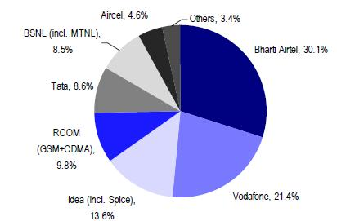
Telecom operators revenue market share march 2011
According to TRAI’s report , gross revenue grew 4.1% in 4QFY11 vs. 4.9% in 3QFY11.
BSNL gained the highest (+49bps revenue share), followed by Idea (+29bps), and Tata Tele (+18bps)
Bharti (-111bps) and RCOM (-59bps) lost share during the quarter.

Slide 10
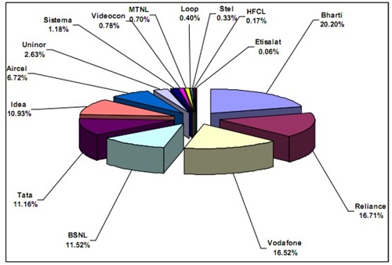
Telecom operator market share:

Slide 11
Top telecom operators in India in accordance to the subscribers base:
Operator Subscriber base Market Share
1 Bharti Airtel 146,293,078 21.34%
2 Reliance comm. 119,351,438 17.37%
3 Vodafone 118,038,438 17.08%
4 BSNL 80,739,935 11.31%
5 Tata Teleservices 80,817,298 11.47%
6 Idea 76,023,551 10.84%
7 Aircel 47,519,629 6.64%
8 Unitech 13,748,300 1.05%
9 Loop 3,009,445 0.45%
10 Sistema 7,121,765 0.86%
11 MTNL 5,342,039 0.81%
12 Videocon 5,616,152 0.43%
13 Stel 1,867,060 0.22%
14 Etisalat 70,829 0.01%
HFCL Infotel 1,132,477 0.13%
All India 706,691,164 100.00
Bharti Airtel remains the market leader with 21.34% share.
Vodafone Essar and reliance communications is catching up close on 2nd position with 17308% & 17.37% and Bsnl is on 3rd spot with 11.31%.

Slide 12
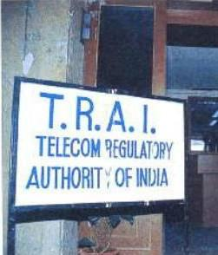

Slide 13
Regulatory framework:
The Department of telecommunications (Government of India) is the main governing body for the industry.
Telephone Regulatory Authority of India (TRAI) assists the Government of India (GoI) to take timely decisions and introduce new technologies in the country.
Framework of Indian telecom industry
Indian Govt. bodies
Independent bodies
Wireless planning coordination (WPC)
Telecom Regulatory Authority of India (TRAI)
Department of telecommunication
Telecom Disputes Settlement and Appellate Tribunal (TDSAT)
Telecomm commission
Group on telecomm and IT

Slide 14
Important regulations:
1. Unified Access Service License Regime (UASL)
Unified licensing marked the end of the license regime in the Indian telecom industry.
Eliminated the need for different licenses for different services. Players are now allowed to offer both mobile and fixed-line services under a single license after paying an additional entry fee.
Does not take into account national and international long-distance services and Internet access services.

Slide 15
Contd…..
2.Access Deficit Charges (ADC)
ADC makes it mandatory for a service provider at the caller’s end to share a percent of the revenue earned with the service provider at the receiver’s end in long-distance telephony.
This subsidises the infrastructure costs of the service provider enabling access at receiver’s end, especially because rental for fixed-line services is low.
3.Universal Service Obligation (USO)
All telecom operators are bound to contribute 5 percent of their revenues to this fund. This system was put in place to bridge the wide gap between urban and rural tele density.
Although it increases the cost burden for the telecom companies, USO helps in building the telecommunication infrastructure in the rural areas.

Slide 16
Emerging trends

Slide 17
TRENDS
Mergers and Acquisitions
FDI

Slide 18
Mergers and Acquisitions:
Following were the mergers and acquisitions that took place:
Vodafone purchased stake in Hutch from Hong Kong's Hutchison Telecom International for USD 11.08 billion.
Reliance Communications Limited has sold 5% equity share capital of its subsidiary Reliance Telecom Infrastructure Limited to international investors across the US, Europe and Asia. The deal was worth USD 337.5 million.
Telekom Malaysia acquired a 49 percent stake in Spice Communications for USD 179 million.

Slide 19
Contd…
Maxis Communications acquired a 74% stake in Aircel for USD 1.08 billion.
Ericsson to design, plan, deploy and manage Bharti Airtel network and facilitate their expansion in the rural areas, under a USD 2 billion contract.

Slide 20
FDI
India's telecom sector received FDI of Rs.48,220 crore in the last 11 years - 8 percent of the total FDI the country received i.e. Rs. 5,80,722 crore.
Foreign direct investment in telecom sector in India has increased by 49.9 percent to $1988.7 million during April-December 2011 against $1326.7 million in same period previous year.

Slide 21
INVESTMENT

Slide 22
Investment- Telecom Sector
The telecom sector witnessed over 17% increase in investment in 2010-11 over the previous financial year, an annual report of the Telecom Regulatory Authority of India (Trai) said.
The capital employed in the telecom sector increased to Rs 3,37,683 crore in 2010-11 from Rs 2,86,837 crore in 2009-10.
The growth in subscriber base resulted in an increase in the gross revenue of telecom services for the year to Rs 1,71,719 crore during the year, a growth of 8.69% from Rs 1,57,985 crore in the previous year.
Capital employed of public sector companies decreased by 7.35% in 2010-11.

Slide 23
The telecom sector is attracting significant domestic and global investment.
The capital investment made by the telecom service industry during 2010-2011 comes up to figure of 3,37,683.
The margins and profits of almost all the telecom companies have been increasing.
In fact there are cases where a significant portion of profit of international telecom companies have been from their operations in India.

